Slide 1




Community-driven cloud initiatives
leveraging FAIR principles
Aparna Radhakrishnan
NOAA Environmental Data Management Workshop 2022

Slide 2





Community driven effort
Special thanks to Pangeo/ESGF Cloud Data Working Group
Content contributions: Ryan Abernathey, Philip Kershaw, Sasha Ames
Other contributions: V. Balaji, Julius Busecke, Ag Stephens, Serguei Nikonov, Kristopher Rand, Charles Stern, Hans Vahlenkamp, Sasha Ames , Ana Privette , Naomi Naik, Mackenzie Blanusa, Chris Blanton, Nkeh Perry Boh, Ben Evans, Richard Smith, Rhys Evans, Zac Flamig, Diana Gergel, Thomas Jackson, Rebecca Monge, Natalie O’Leary, Zouberou Sayibou.
A.Radhakrishnan (NOAA EDMW 2022), Community-driven cloud initiatives leverage FAIR principles

Slide 3
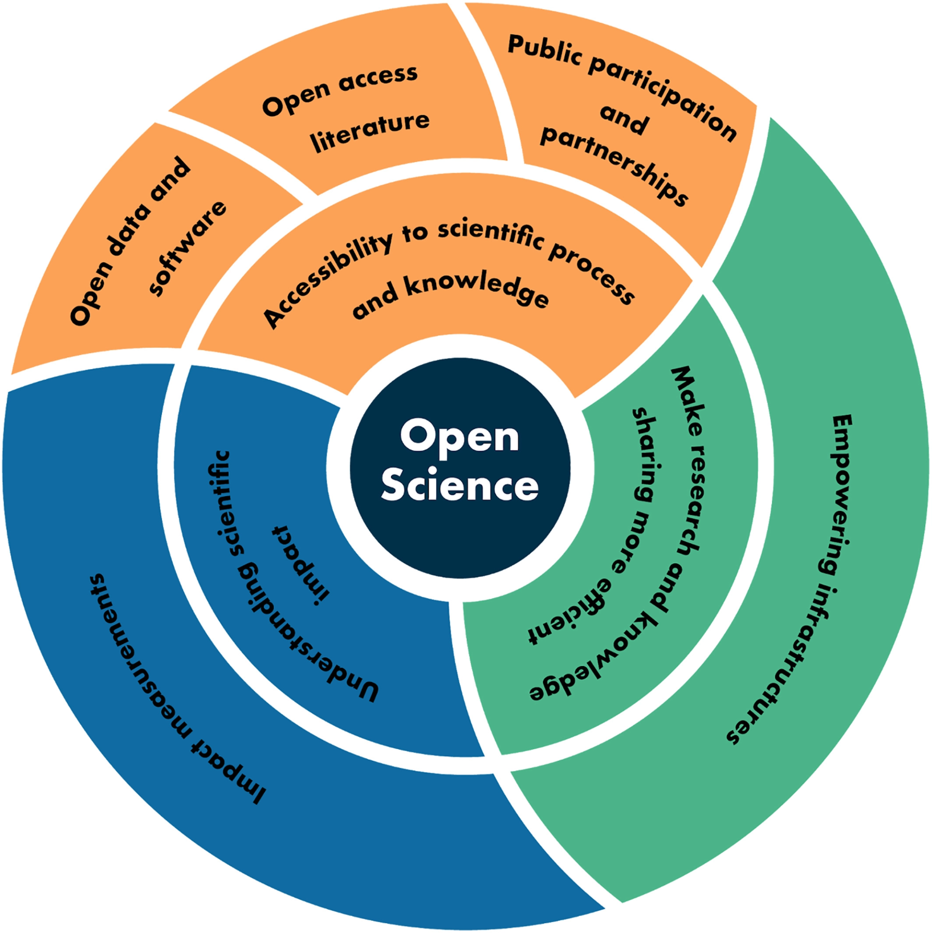

Open Science
Image credit
Collaborative culture enabled by technology that empowers the open sharing of data, information, and knowledge within the scientific community and the wider public to accelerate scientific research and understanding.
Rahul Ramachandran, Kaylin Bugbee, Kevin Murphy, 2021
https://doi.org/10.1029/2020EA001562
A.Radhakrishnan (NOAA EDMW 2022), Community-driven cloud initiatives leverage FAIR principles

Slide 4




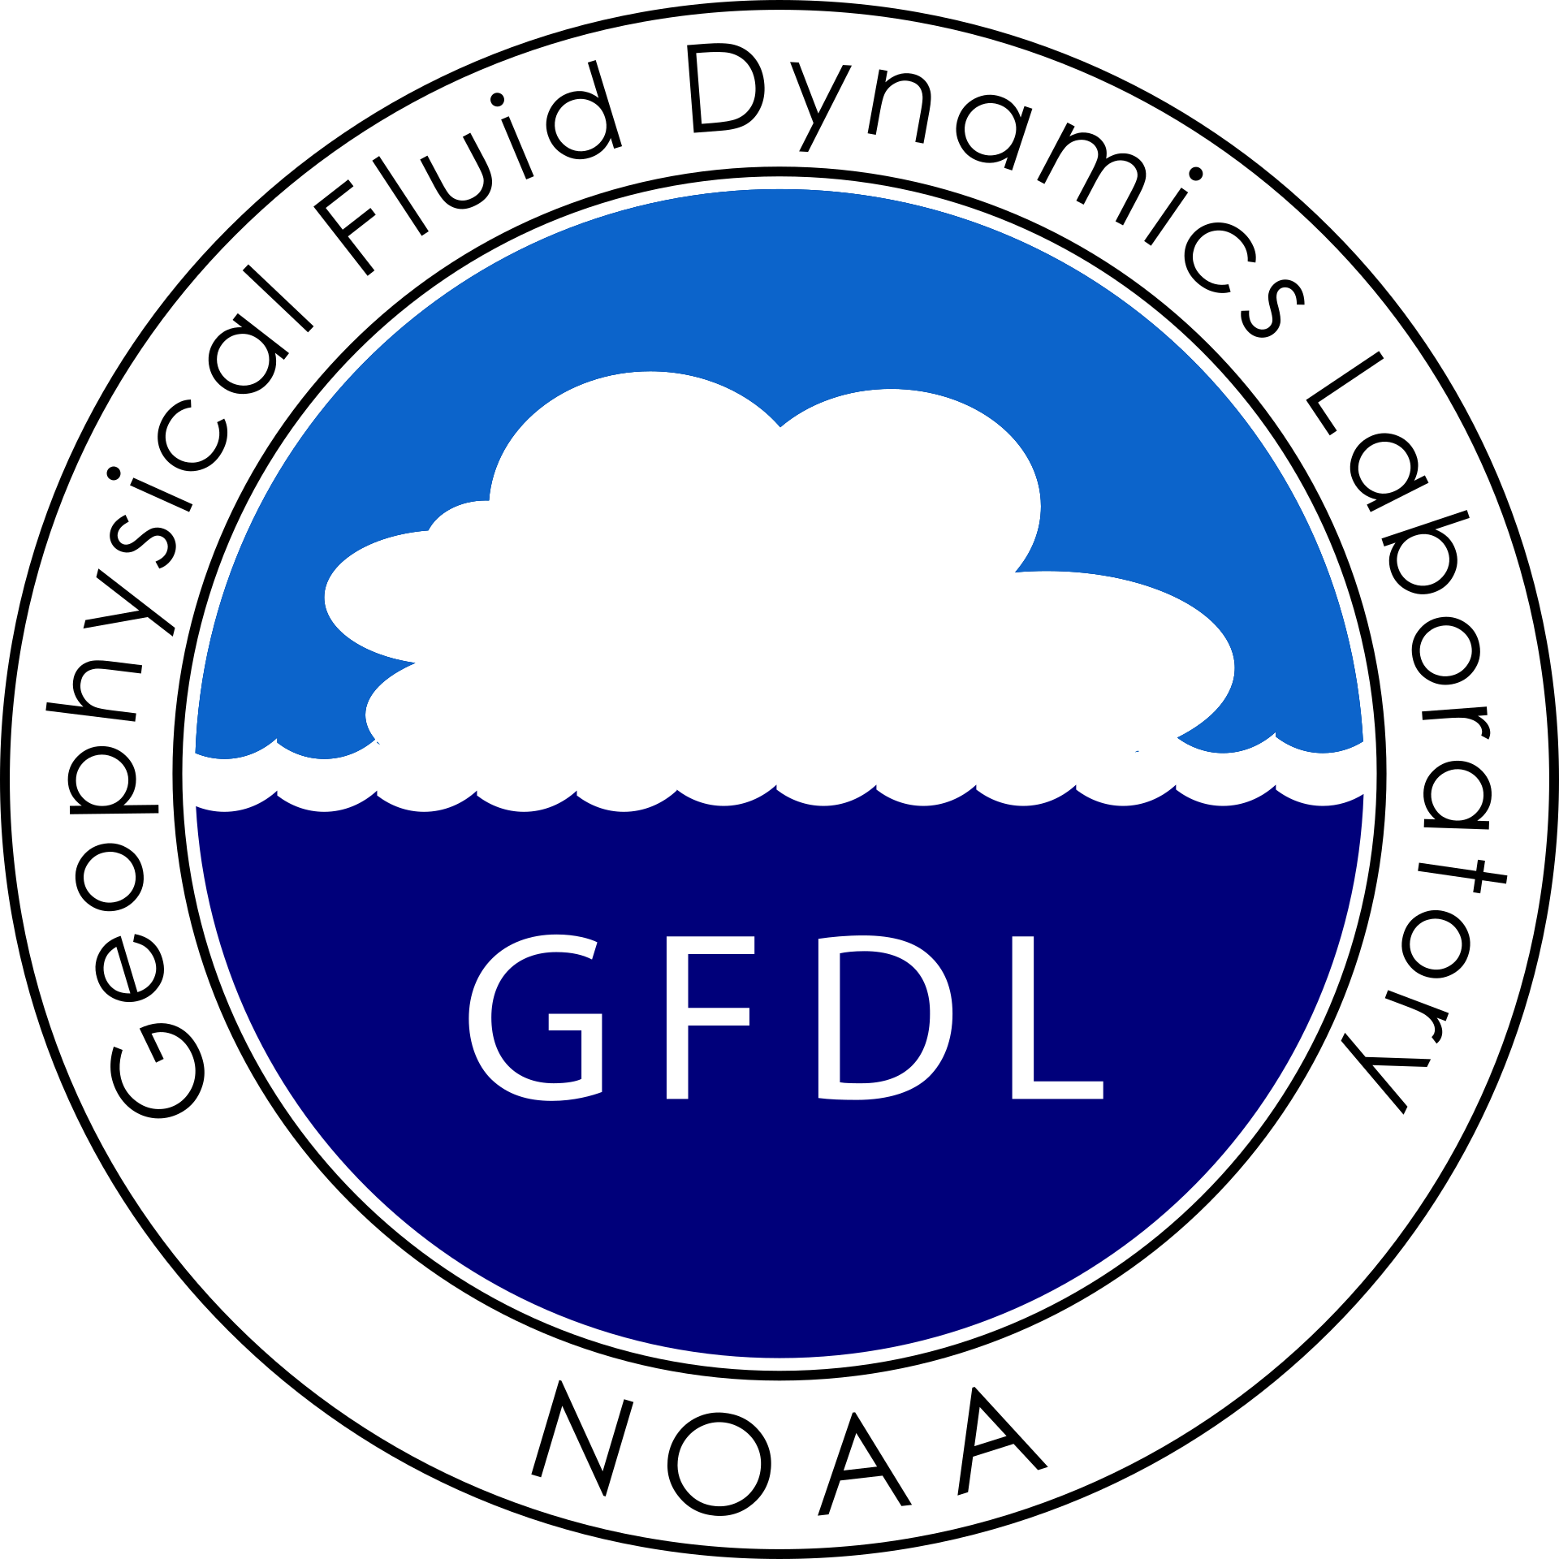
F
A
I
R
Findable
Accessible
Interoperable
Reusable
A.Radhakrishnan (NOAA EDMW 2022), Community-driven cloud initiatives leverage FAIR principles
Notes:
FAIR means thinking about the people who could benefit from your data“, Lambert Heller, leader of the Open Science Lab at TIB, the German National Library of Science and Technology, explains in Nature Index.

Slide 5
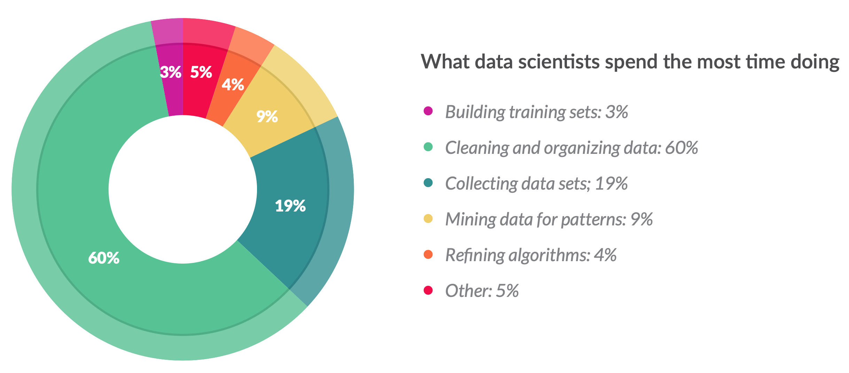
Need Analysis-Ready datasets (ARD)
How do data scientists spend their time?
Crowdflower Data Science Report (2016)
ARD is readily findable and usable!
A.Radhakrishnan (NOAA EDMW 2022), Community-driven cloud initiatives leverage FAIR principles

Slide 6
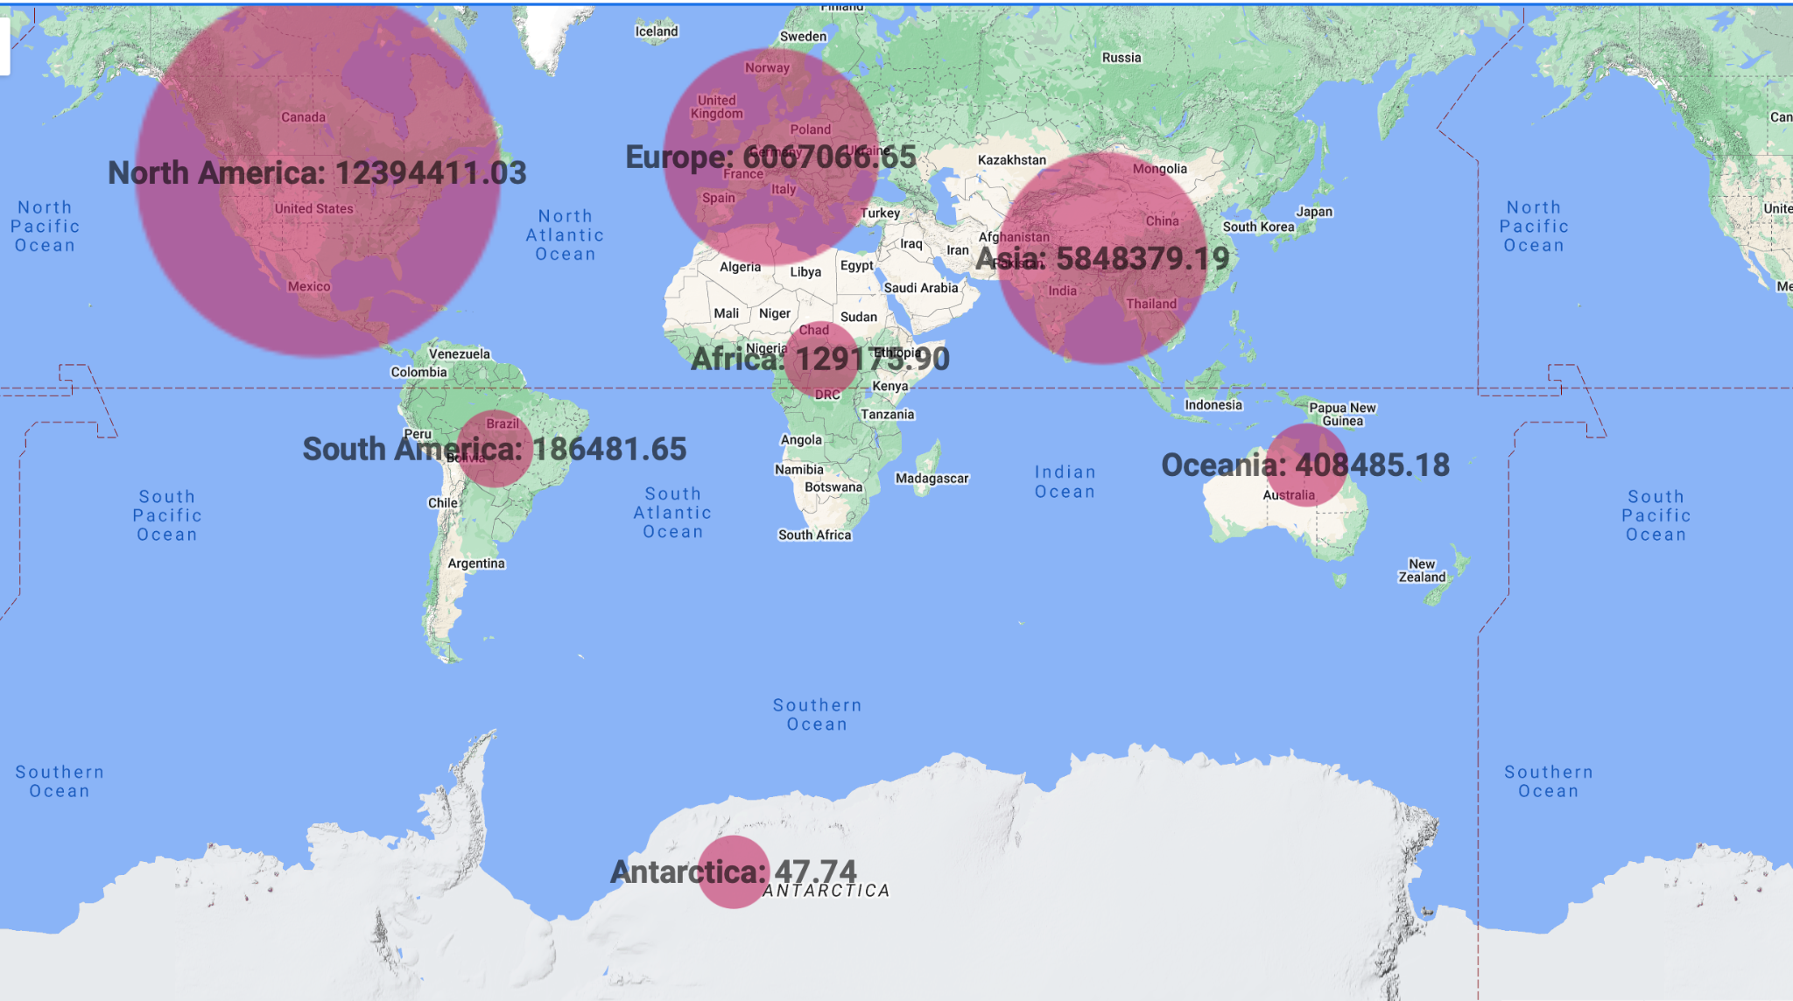
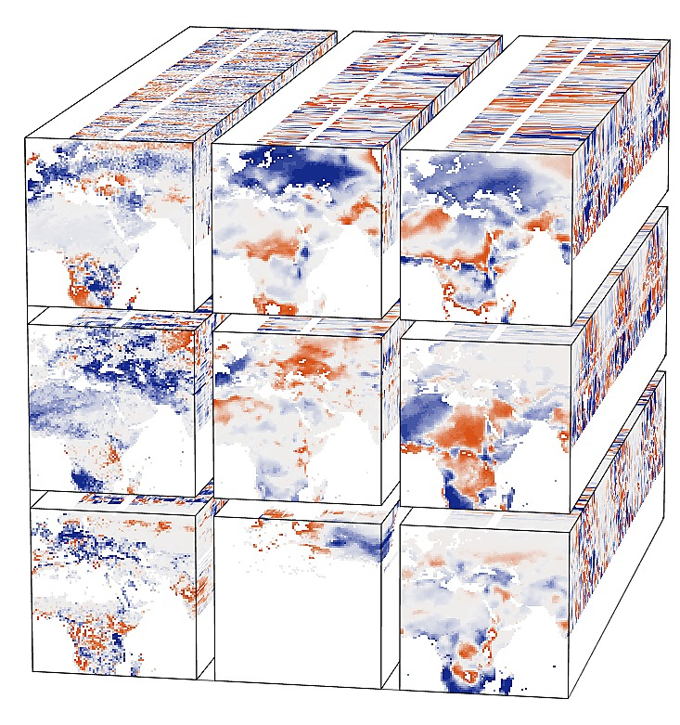
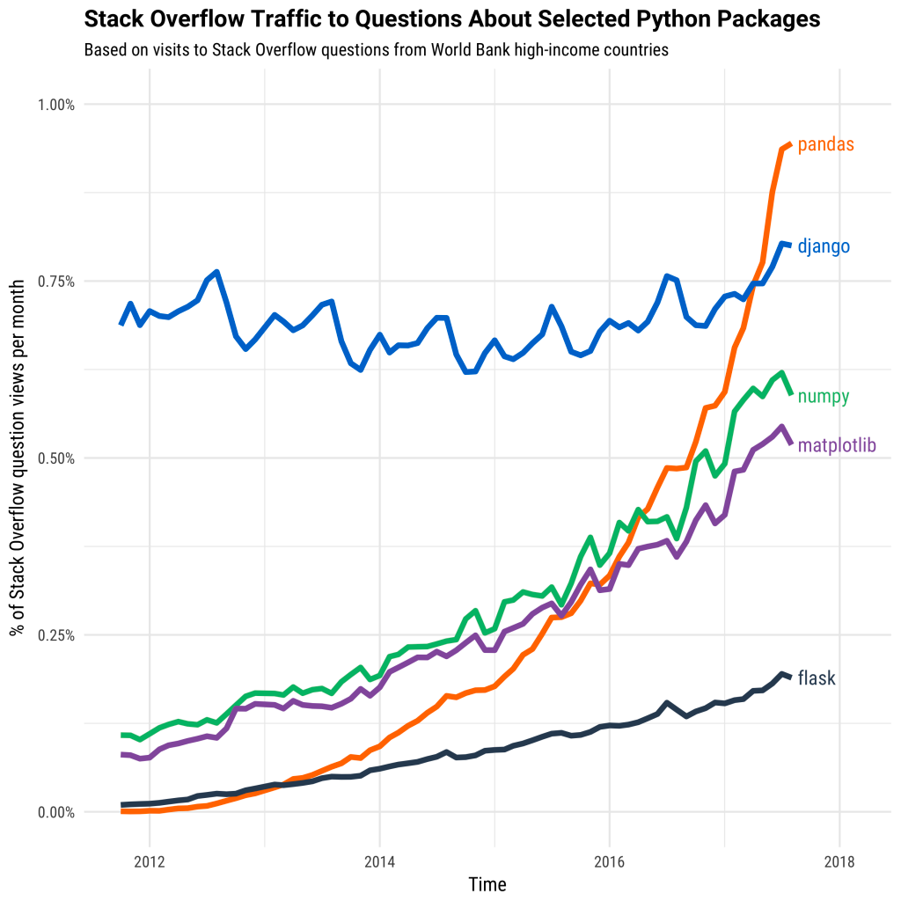

Need Analysis-Ready Cloud-Optimized Datasets (ARCO)
A.Radhakrishnan (NOAA EDMW 2022), Community-driven cloud initiatives leverage FAIR principles

Slide 7
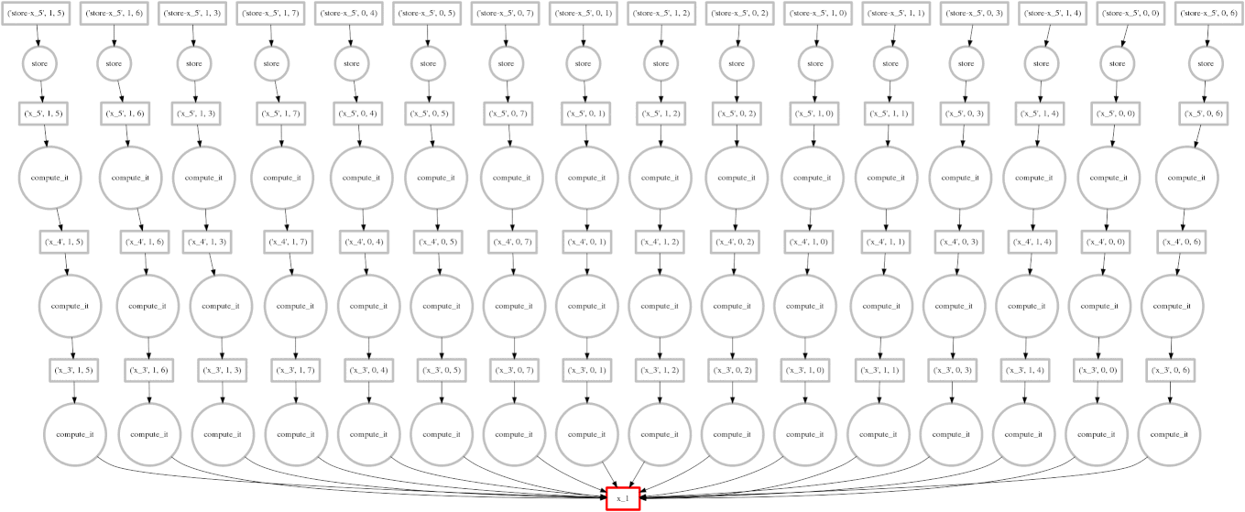

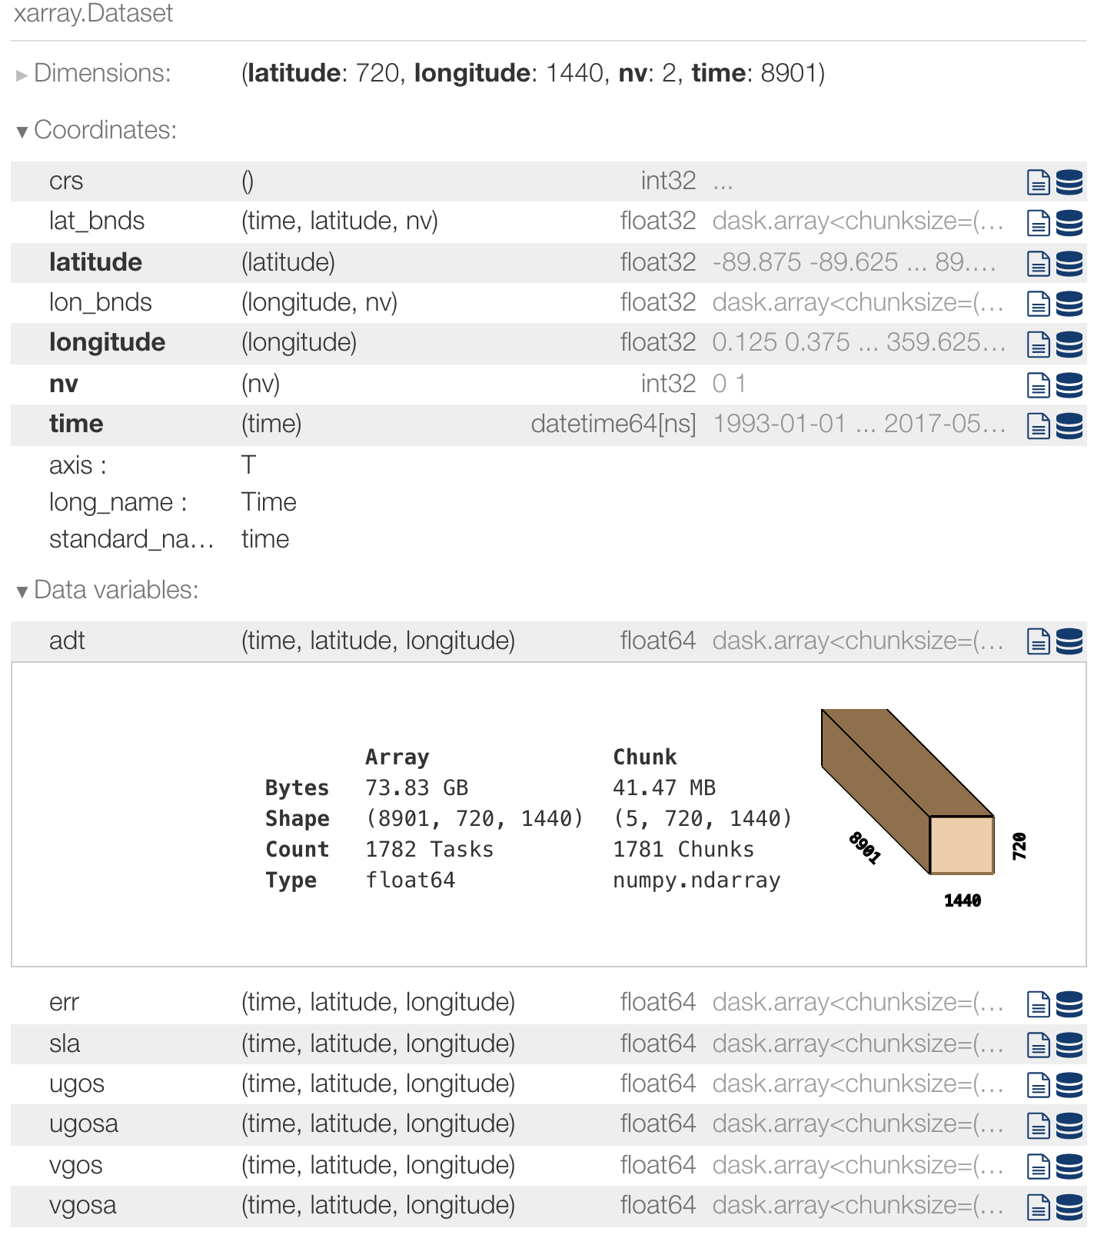
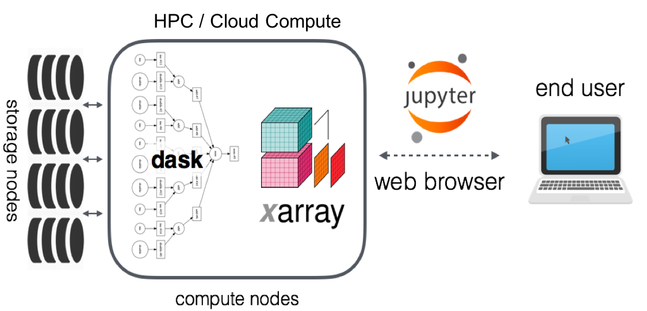

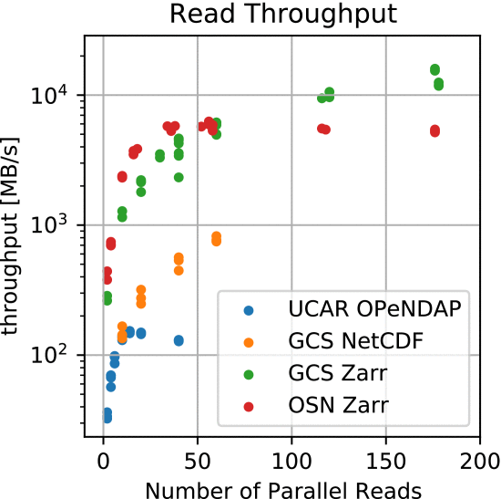
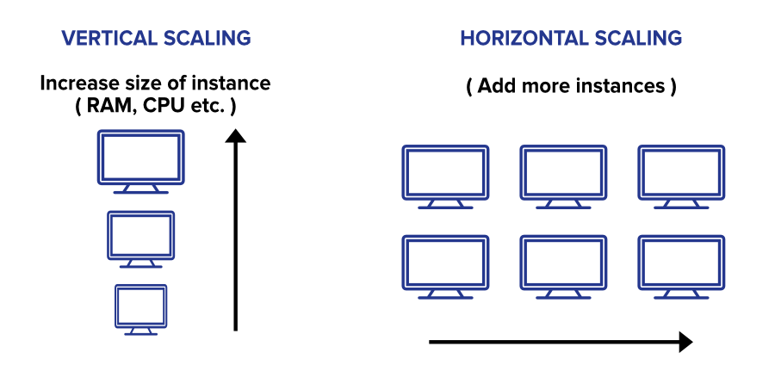
Cloud-Native Scientific Data Analytics
1. Analysis-Ready,
Cloud-Optimized Data
2. Data-Proximate Computing
3. Elastic Distributed Processing
R. P. Abernathey et al., "Cloud-Native Repositories for Big Scientific Data," in Computing in Science & Engineering, vol. 23, no. 2, pp. 26-35, 1 March-April 2021, doi: 10.1109/MCSE.2021.3059437.

Slide 8

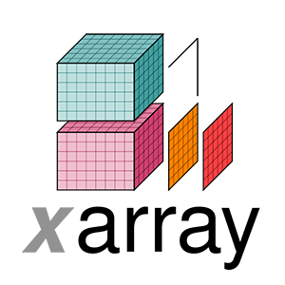



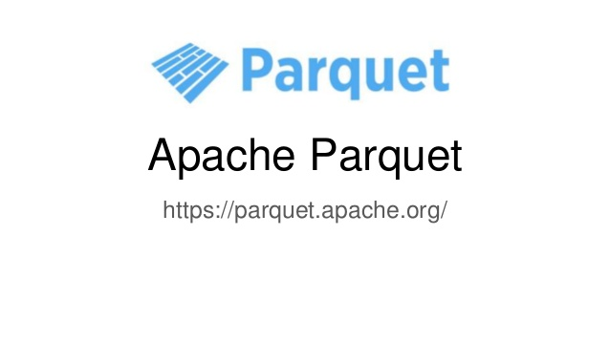
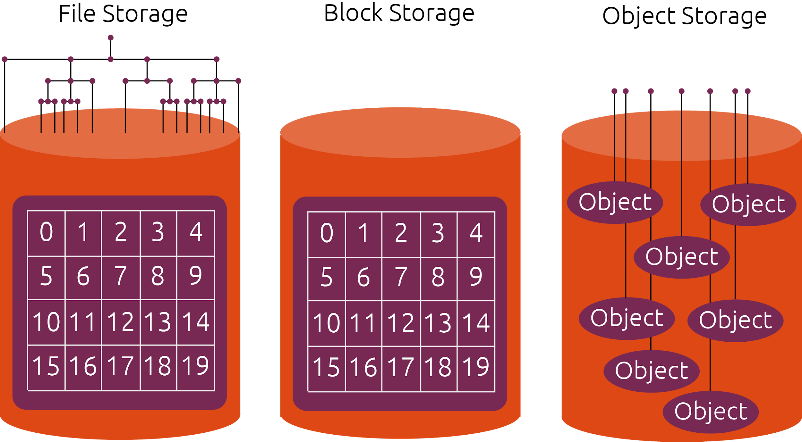

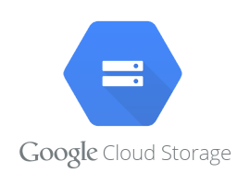
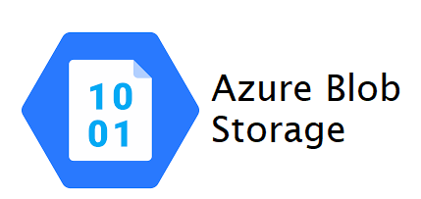

ARCO Data
Analysis Ready, Cloud Optimized
What is “Cloud Optimized”?
Compatible with object storage (access via HTTP)
Supports lazy access and intelligent subsetting
Integrates with high-level analysis libraries and distributed frameworks
R. P. Abernathey et al., "Cloud-Native Repositories for Big Scientific Data," in Computing in Science & Engineering, vol. 23, no. 2, pp. 26-35, 1 March-April 2021, doi: 10.1109/MCSE.2021.3059437.
Slide credit: Ryan Abernathey, Pangeo-forge FOSS4G 2022

Slide 9
Initiatives to host CMIP6 ARD and ARCO data
in the cloud
A.Radhakrishnan (NOAA EDMW 2022), Community-driven cloud initiatives leverage FAIR principles

Slide 10





Democratizing access to climate model output
CMIP6 S3 bucket
arn:aws:s3:::esgf-world
AWS CLI Access aws s3 ls s3://esgf-world/ --no-sign-request
https://esgf-world.s3.amazonaws.com/index.html
Intake-esm catalog
https://cmip6-nc.s3.amazonaws.com/esgf-world.csv.gz
THREDDS catalog
https://aws-cloudnode.esgf.io/thredds/catalog/catalog.html
SpatioTemporal Asset Catalogs (STAC) underway
arn:aws:s3:::cmip6-pds
AWS CLI Access aws s3 ls s3://cmip6-pds --no-sign-request
https://cmip6-pds.s3.amazonaws.com/index.html#CMIP6/
Intake-esm catalog
https://cmip6-pds.s3.amazonaws.com/pangeo-cmip6.csv
STAC catalogs underway
Checkout the CMIP6 registry in AWS to read more information, including CMIP6 data citations.
A.Radhakrishnan (NOAA EDMW 2022), Community-driven cloud initiatives leverage FAIR principles

Slide 11
Drive data publication infrastructure in the cloud.
A.Radhakrishnan (NOAA EDMW 2022), Community-driven cloud initiatives leverage FAIR principles

Slide 12
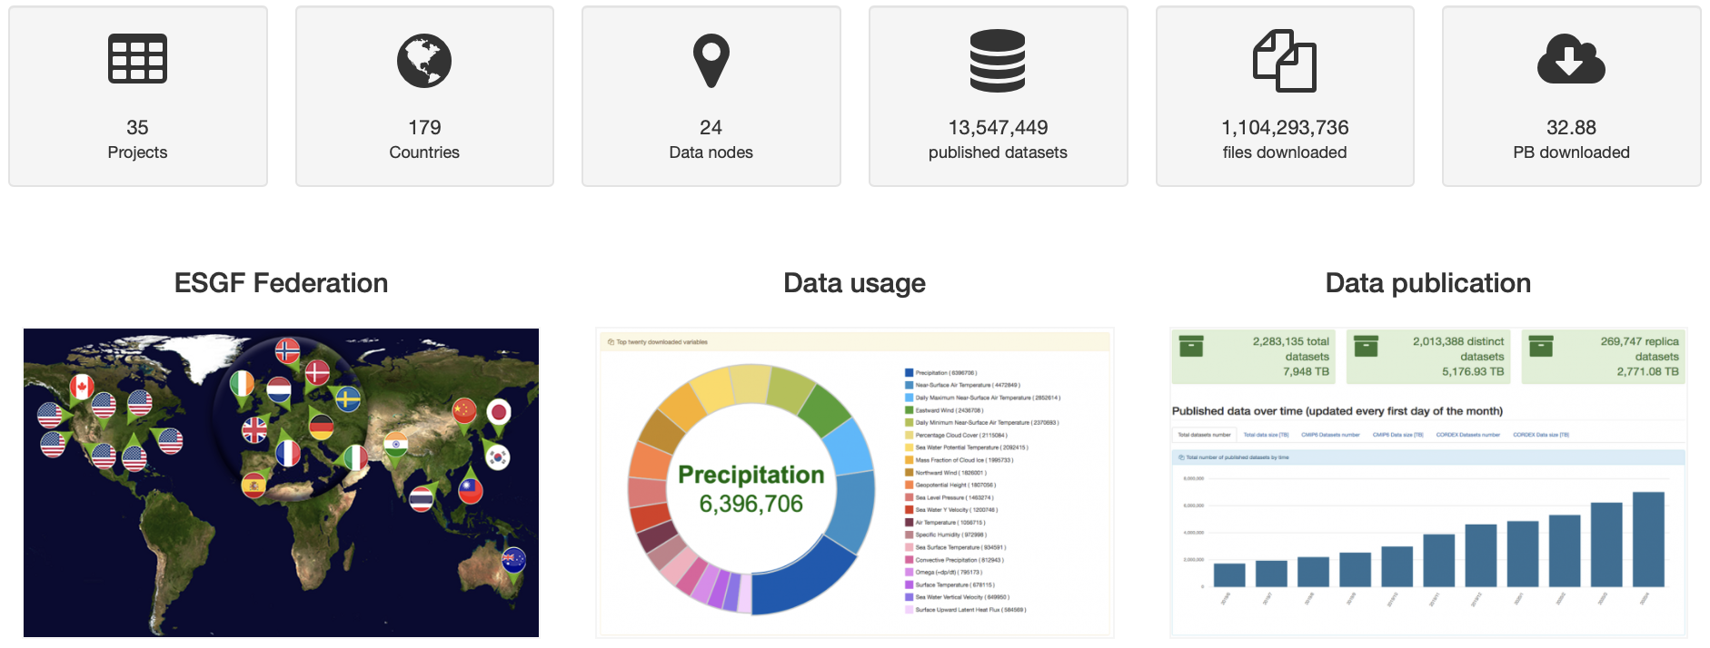
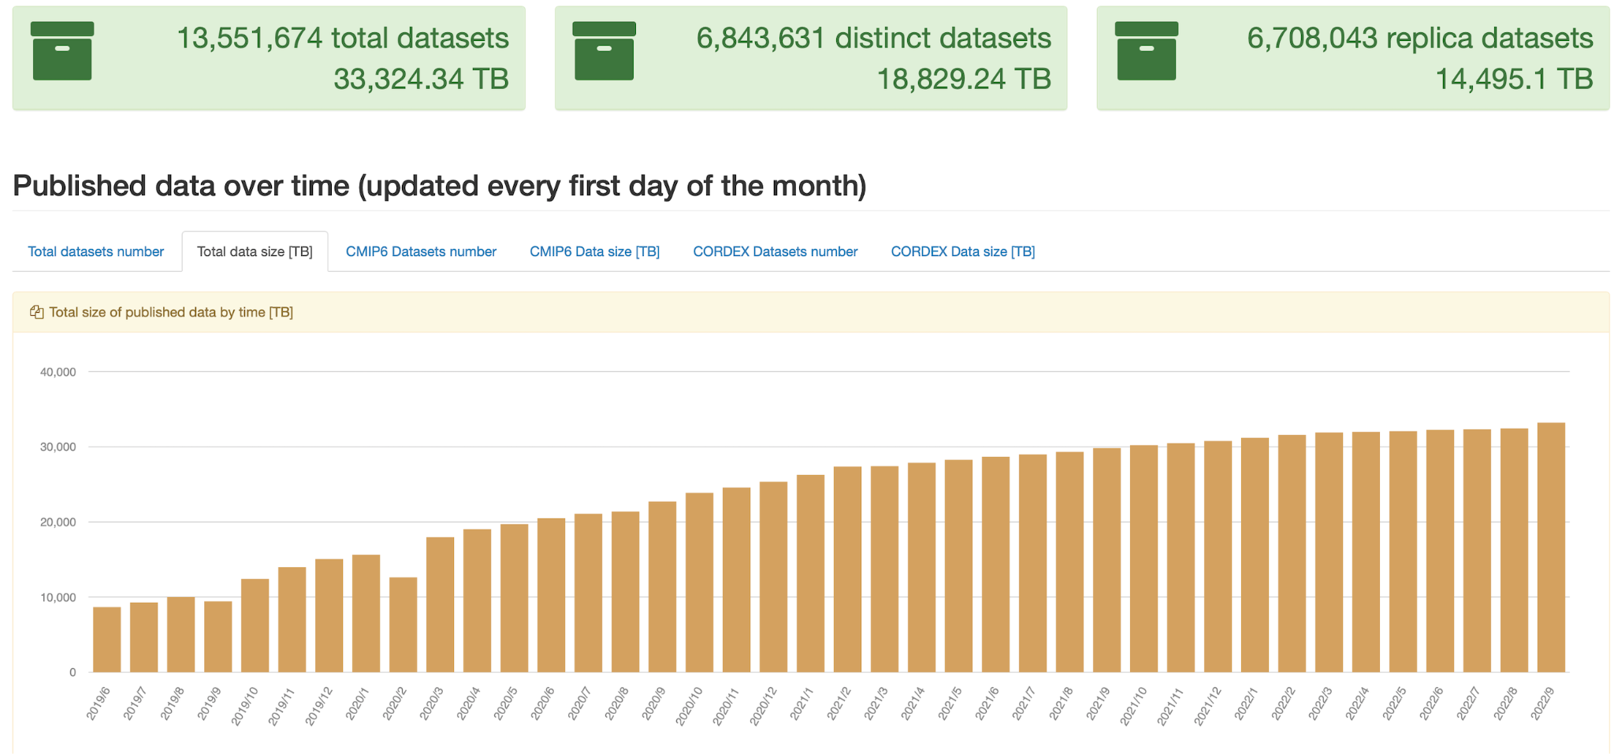
Earth System Grid Federation(ESGF)- A globally distributed archive of climate data
ESGF Dashboard: http://esgf-ui.cmcc.it
Challenge and opportunity
Accelerate research ->Collaborate-> Diversify the audience
Towards a more accessible, discoverable data holding in the cloud.
A.Radhakrishnan (NOAA EDMW 2022), Community-driven cloud initiatives leverage FAIR principles

Slide 13




ESGF Future Architecture – Recap and Progress to date
Philip Kershaw, ESGF - IS-ENES 2021
Platforms and systems administration
Search services
ID Management and Access Entitlement
Modular, scalable architecture: Containers, Kubernetes
Embrace infrastructure-as-code approach
Modernise, centralise and simplify
Use community standards: STAC
Modernise, centralise and simplify
Use industry standards: OpenID Connect / OAuth 2.0
Container and Container+Kubernetes installs available
Deployed on AWS (GFDL) and CEDA
Major community engagement on use of STAC for ESM data
Prototype developed by CEDA
Integration tests
CoG and MetaGrid futures??
OpenID Connect / OAuth 2.0 done
New Authorisation system with Open Policy Agent
Authentication integrated with C4I in test
Progress and Achievements
IS-ENES3 has received funding from the European Union’s Horizon 2020 research and innovation programme under grant agreement No 824084

Slide 14
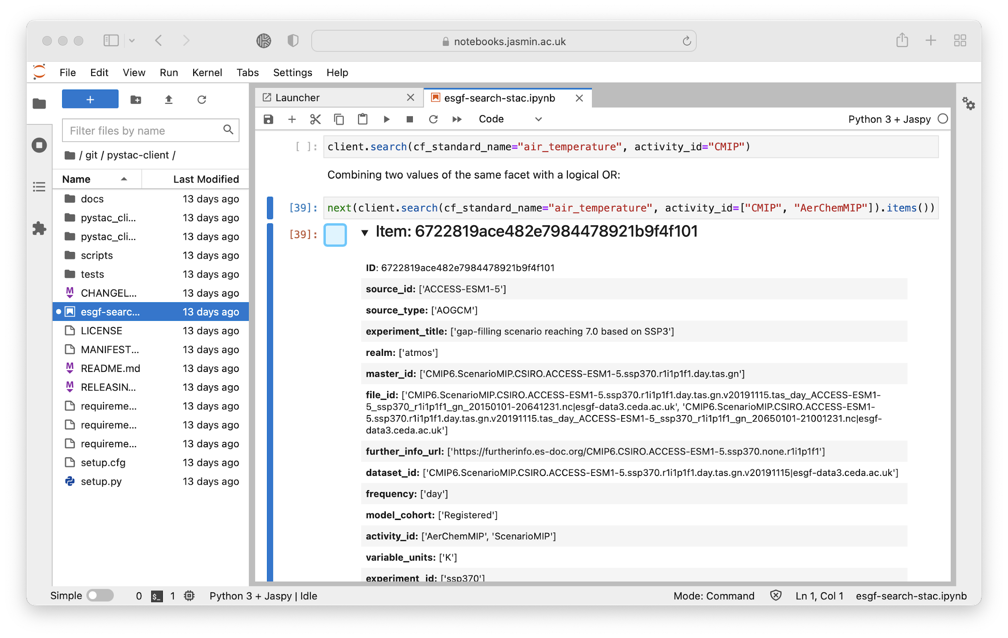
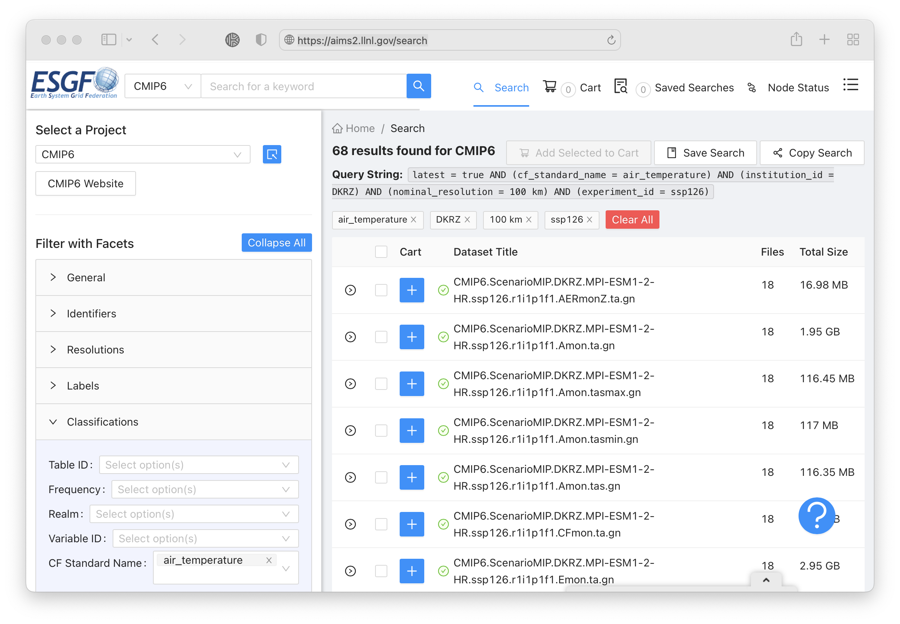

Making data collection pleasant
Search as you go in your notebook: Spatio Temporal Asset API
client.search(cf_standard_name=”air_temperature”,
activity_id=”CMIP”]).items()
Metadata, metadata..
Leverage community data standards.
E.g. Climate Forecast conventions, CMIP Data Reference Syntax and controlled vocabulary
Support diverse user groups
Extend to different data formats
Future: MetaGrid search interface with STAC back-end
A.Radhakrishnan (NOAA EDMW 2022), Community-driven cloud initiatives leverage FAIR principles

Slide 15






Future architecture of ESGF
HPC
Institutional Copies
Cloud Optimized Copy of Data
Cloud Optimized Copy of Data
Cloud Platform
Search
Download
Web
Processing
Service
Federated Search and Data Access
ESGF Node
ESGF Node
ESGF Node
ESGF Node
ESGF Node
Cloud-hosted Node
Data Replication
Publishing and QA
Modelling Centre
Modelling Centre
Modelling Centre
Modelling Centre
Modelling Centre
Modelling Centre
Adapted from: Philip Kershaw, ESGF - CPCMW 2022
A.Radhakrishnan (NOAA EDMW 2022), Community-driven cloud initiatives leverage FAIR principles

Slide 16

Example of ARCO Data
Everything in one dataset object
Rich metadata
Chunked appropriately for analysis
Slide credit: Ryan Abernathey, Pangeo-forge FOSS4G 2022
https://catalog.pangeo.io/browse/master/ocean/sea_surface_height/

Slide 17
A reproducible pathway to ARCO data
A.Radhakrishnan (NOAA EDMW 2022), Community-driven cloud initiatives leverage FAIR principles

Slide 18
Acknowledgement
Charles Stern (Columbia / LDEO)
Joe Hamman (CarbonPlan)
Anderson Banihirwe (CarbonPlan)
Rachel Wegener (U. Maryland)
Chiara Lepore (GRO Intelligence)
Sean Harkins (Development Seed)
Alex Merose (Google Research)
Tom Augspurger (Microsoft)
Martin Durant (Anaconda)
Many recipe contributors
Funding: NSF Earthcube Program ($1.5M for 3 years)

Slide 19
Problem:
Making ARCO Data is Hard!
To produce useful ARCO data, you must have:
Domain Expertise: How to find, clean, and homogenize data
Tech Knowledge: How to efficiently produce cloud-optimized formats
Compute Resources: A place where to stage and upload the ARCO data
Analysis Skills: To validate and make use of the ARCO data.
😩
Data Scientist
Slide credit: Ryan Abernathey, Pangeo-forge FOSS4G 2022

Slide 20



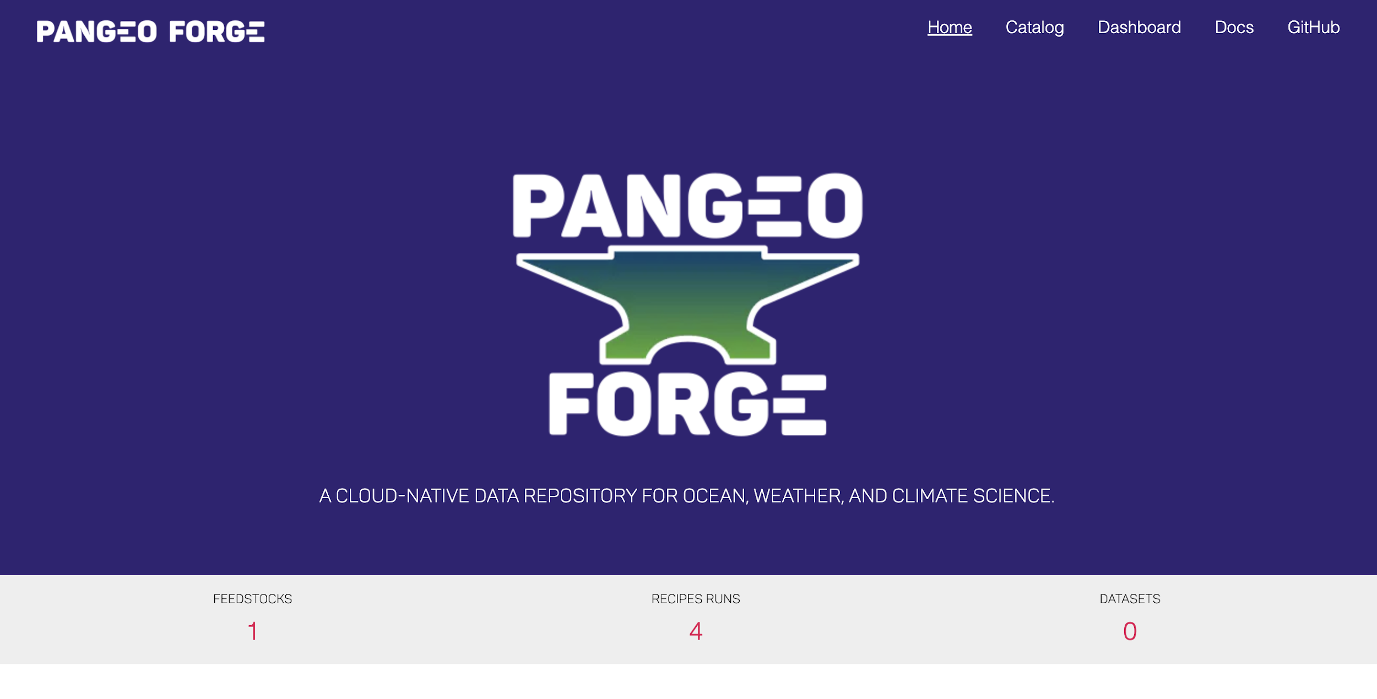
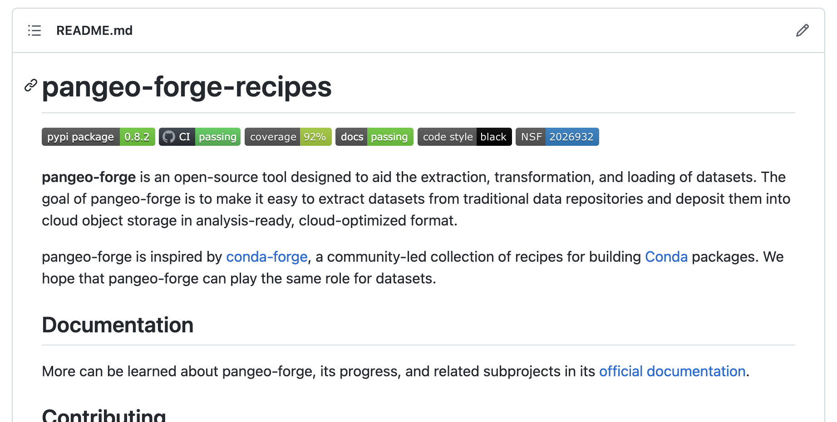
Pangeo Forge Recipes
Pangeo Forge Cloud
https://github.com/pangeo-forge/pangeo-forge-recipes
https://pangeo-forge.org/
Open source python package for describing and running data pipelines (“recipes”)
Cloud platform for automatically executing recipes stored in GitHub repos.
Slide credit: Ryan Abernathey, Pangeo-forge FOSS4G 2022

Slide 21




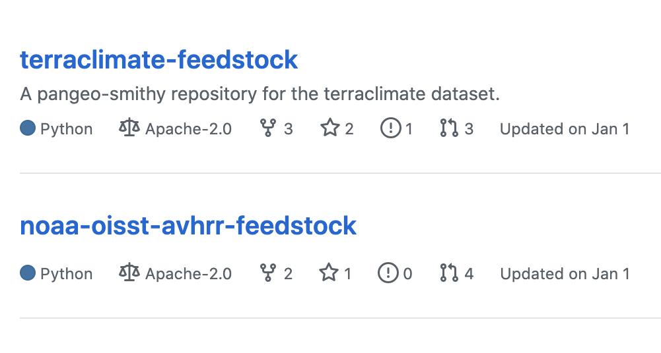
Pangeo Forge Cloud
https://pangeo-forge.org/
Contains the code and metadata for one or more Recipes
Bakery
Feedstock
Storage
GCS
Runs the recipes in the cloud using elastic scaling clusters
Slide credit: Ryan Abernathey, Pangeo-forge FOSS4G 2022

Slide 22


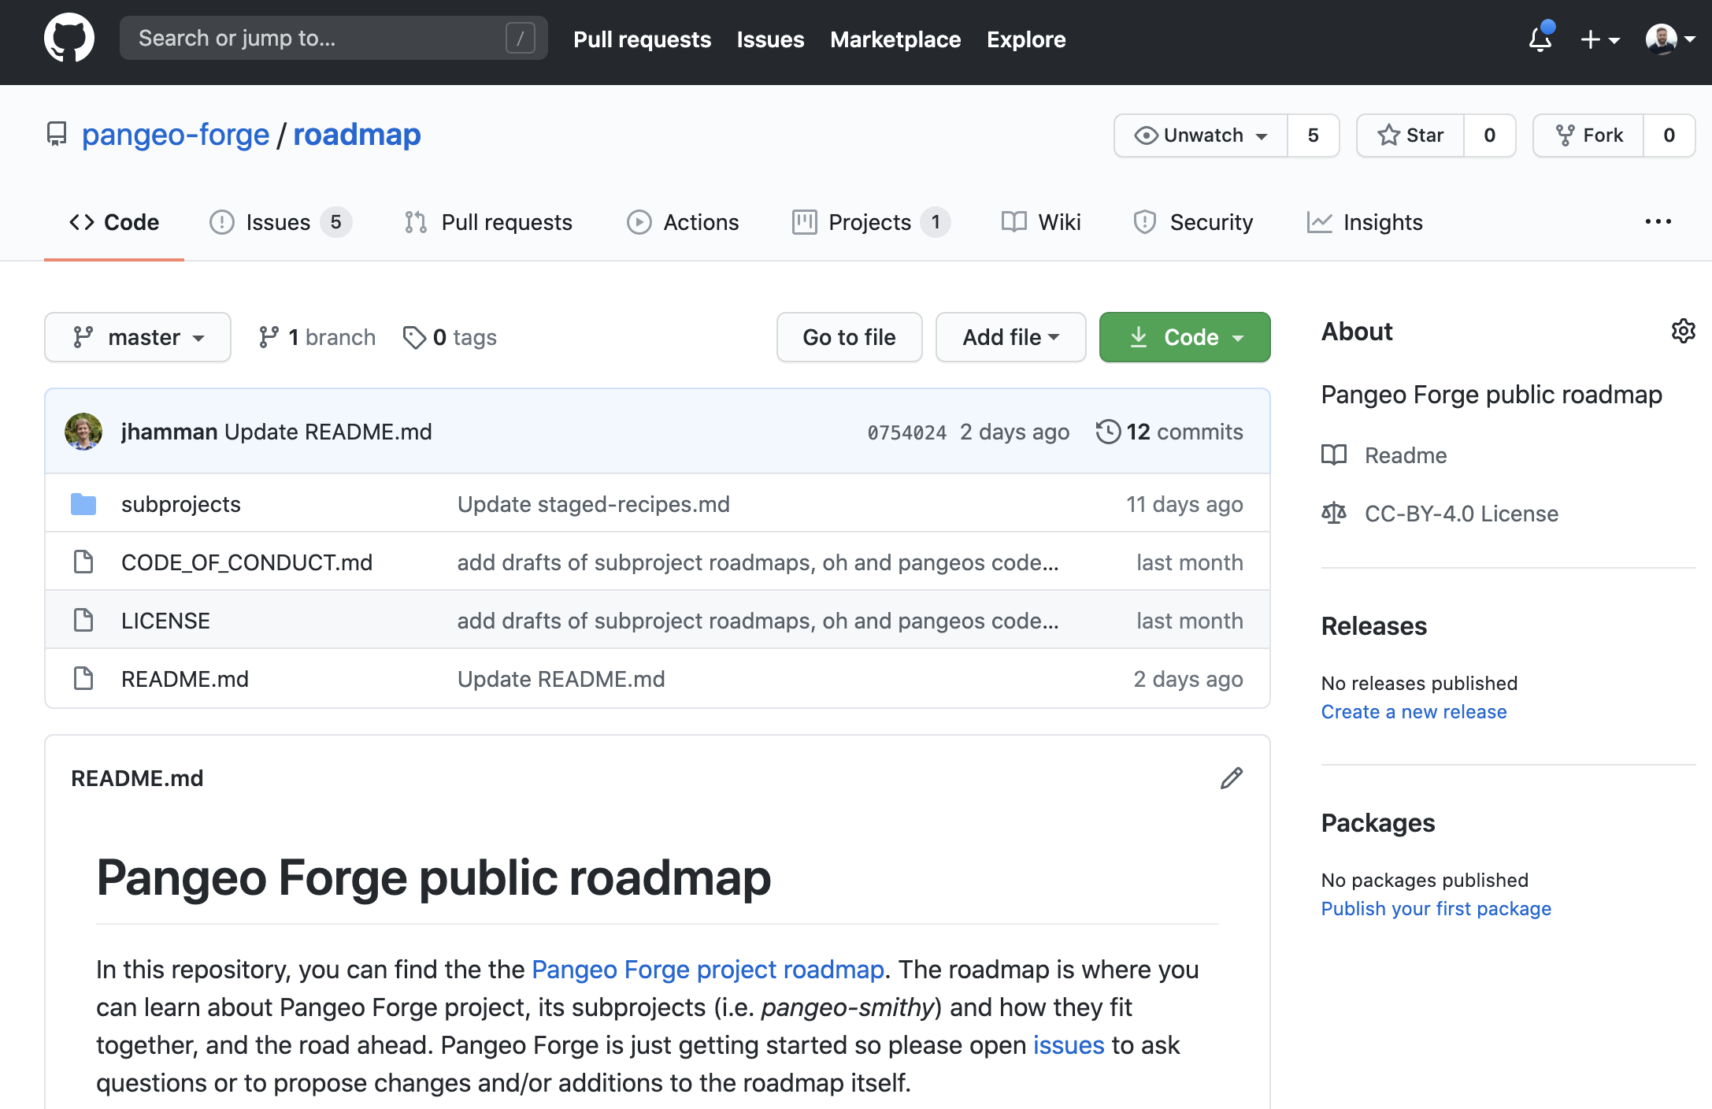
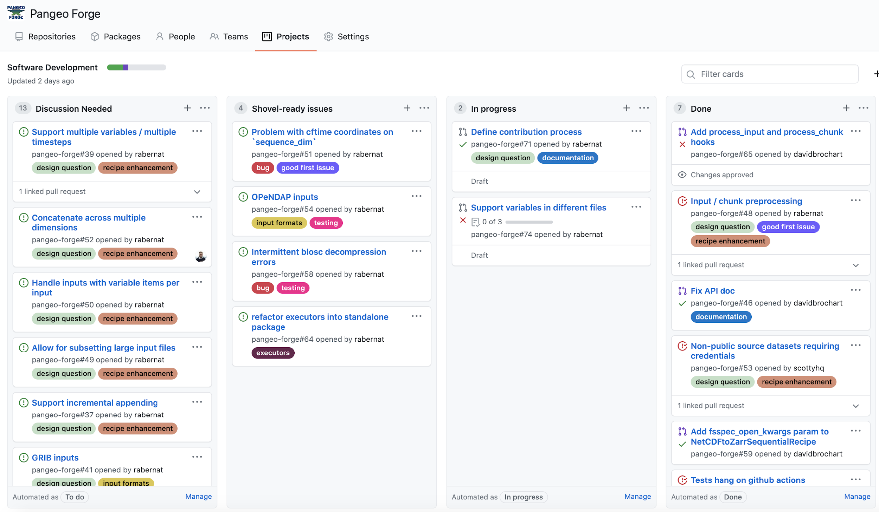
Pangeo Forge Development
This is a 💯% open project! Join us!
https://github.com/pangeo-forge/pangeo-forge-recipes
Slide credit: Ryan Abernathey, Pangeo-forge FOSS4G 2022

Slide 23
Key takeaways
Prioritization
Emphasis on data management (not a by-product or an after-thought)
Data management considerations integral to modeling and analysis workflows
E.g. Data organization, diagnostics requirements, provenance
Motivated by NOAA PARR (Public Access to Research Results) requirements
Organizational Guidance: GFDL FAIR use policy, Co-authorship policy
F in FAIR may also mean Fundability to sustain
Research acceleration
Outreach and collaboration
Extend, not always build.
Recognition and traceability
Collaboration with NOAA EDMC for a robust DOI infrastructure (includes NODD).
Think beyond citations as an impact metric!
A.Radhakrishnan (NOAA EDMW 2022), Community-driven cloud initiatives leverage FAIR principles
Notes:
E.g. Data organization, Simulation requirements,

Slide 24
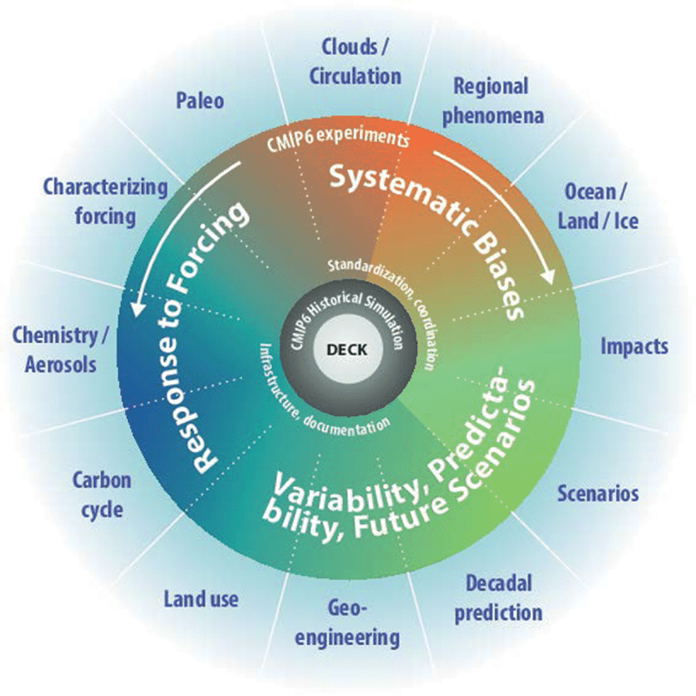








Resources and workflow used
Models | Experiments
GFDL-ESM4 CESM2 IPSL-CM6A-LR CNRM-CM6-1 CNRM-ESM-1 UKESM1-0-LL | Historical (1980-2011) 1%CO₂ (0119-0150) Abrupt-4xCO₂ (0119-0150)
CMIP6
THOR: Tracking the impact of global Heating on Ocean Regimes
intake-esm
Slide credit: Zouberou Sayibou, Linking ENSO to Oceanic Dynamical Regimes using Transparent Machine Learning
CIMES student intern 2021
We ran our entire analysis in the cloud.
≅114GB of data used in the analysis, zero data downloads.

